Slide 1
MQTT Protocol
Vraj Suratwala
Department of ICT, VNSGU

Slide 2
Introduction
MQTT (Message Queuing Telemetry Transport) is a lightweight, publish-subscribe messaging protocol designed mainly for IoT and machine-to-machine (M2M) communication.
It is especially useful for devices with limited processing power, memory, and bandwidth, and for networks where connectivity may be slow or unreliable.
MQTT works on top of TCP/IP and follows a client-server architecture using a central component called a Broker.

Slide 3
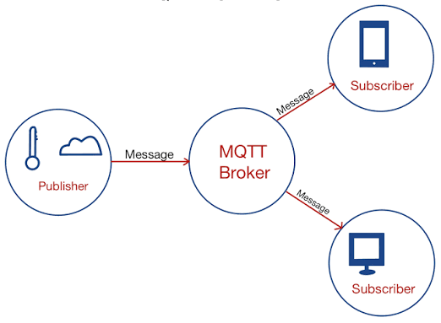

Working Diagram

Slide 4
MQTT Architecture
The main components of MQTT are:
Publisher → MQTT Broker → Subscriber
1. Publisher
  A publisher is an IoT device or application that sends messages to the MQTT broker.
  Example:
    A temperature sensor publishes 30°C.
2. MQTT Broker
  The broker is the central server that receives messages from publishers and distributes them to the appropriate subscribers.
  It is responsible for:
    Receiving messages
    Managing clients
    Filtering messages based on topics
    Delivering messages to subscribers
3. Subscriber
  A subscriber is a device or application that receives messages from the broker.
  A subscriber must subscribe to a particular topic to receive messages related to that topic.

Slide 5
MQTT Topics
MQTT uses topics to organize messages.
For example:
  home/room1/temperature
  A temperature sensor can publish data to this topic, while a mobile application can subscribe to the same topic.
  The broker then forwards the published message to all clients subscribed to that topic.

Slide 6
Working of MQTT
Step 1: IoT device connects to the MQTT Broker.
Step 2: Publisher publishes a message to a specific topic.
Step 3: Broker receives the message.
Step 4: Broker identifies subscribers interested in that topic.
Step 5: Broker forwards the message to those subscribers.
Example:
  Temperature Sensor
  ↓ Publish: 32°C
  MQTT Broker
  ↓ Topic: home/temperature
  Mobile App / Cloud Application

Slide 7
Quality of Service (QoS)
MQTT provides three QoS levels to control message delivery reliability:
QoS Name Meaning
0 At most once Message is delivered without confirmation.
1 At least once Message is guaranteed to be delivered, but duplicates may occur.
2 Exactly once Message is delivered exactly once.
  QoS 0 → Fastest
  QoS 1 → Reliable
  QoS 2 → Most reliable but more overhead

Slide 8
Advantages
Lightweight and requires low bandwidth.
Suitable for resource-constrained IoT devices.
Supports publish-subscribe communication.
Provides different QoS levels.
Works well with unreliable networks.
Supports communication between a large number of devices.
Easy integration with cloud and IoT platforms.

Slide 9
Applications
MQTT is commonly used in:
  Smart homes
  Industrial IoT
  Smart agriculture
  Healthcare monitoring
  Smart cities
  Vehicle tracking
  Remote sensor monitoring

Slide 10
MQTT Paho Library
IMP.

Slide 11
Definition
Paho MQTT is an open-source MQTT client library developed by the Eclipse Foundation. It provides implementations of the MQTT protocol and allows applications and IoT devices to connect to an MQTT broker, publish messages, and subscribe to topics.
Paho supports several programming languages, including Python, Java, JavaScript, C, C++, and Go.
For IoT applications, the Paho Python library is commonly used because it makes MQTT communication simple to implement.

Slide 12
Paho MQTT Architecture
The Paho library acts as an MQTT client between an IoT application and an MQTT broker.
IoT Application using Paho
↓
MQTT Broker
↓
Other MQTT Clients
The Paho client can perform operations such as:
  Connecting to an MQTT broker
  Publishing messages
  Subscribing to topics
  Receiving messages
  Disconnecting from the broker

Slide 13
Paho MQTT Python Library
In Python, the library can be installed using:
  pip install paho-mqtt
It can then be imported into a Python program:
  import paho.mqtt.client as mqtt

Slide 14
Basic Working
The basic MQTT communication using Paho follows these steps:
  Create Client → Connect to Broker → Publish/Subscribe → Exchange Messages → Disconnect
For example, a temperature sensor application can use Paho to publish temperature data:
  client.publish("home/temperature", "30°C")
Another application can subscribe to the same topic:
  client.subscribe("home/temperature")
The MQTT broker receives the published message and delivers it to the subscribed client.

Slide 15
Important Paho Functions
Function Purpose
mqtt.Client() Creates an MQTT client
connect() Connects the client to the broker
publish() Publishes a message
subscribe() Subscribes to a topic
loop_start() Starts network processing in the background
loop_forever() Continuously processes MQTT network traffic
disconnect() Disconnects from the broker

Slide 16
Advantages of Paho MQTT
Open-source and widely used.
Easy to integrate with IoT applications.
Supports MQTT communication efficiently.
Available for multiple programming languages.
Provides APIs for publish and subscribe operations.
Suitable for resource-constrained IoT applications.
Supports MQTT features such as QoS and retained messages.

Slide 17
Applications
Paho MQTT can be used in:
Smart home systems
Sensor monitoring
Industrial IoT
Smart agriculture
Healthcare monitoring
Vehicle and device tracking
Cloud-based IoT applications

Slide 18
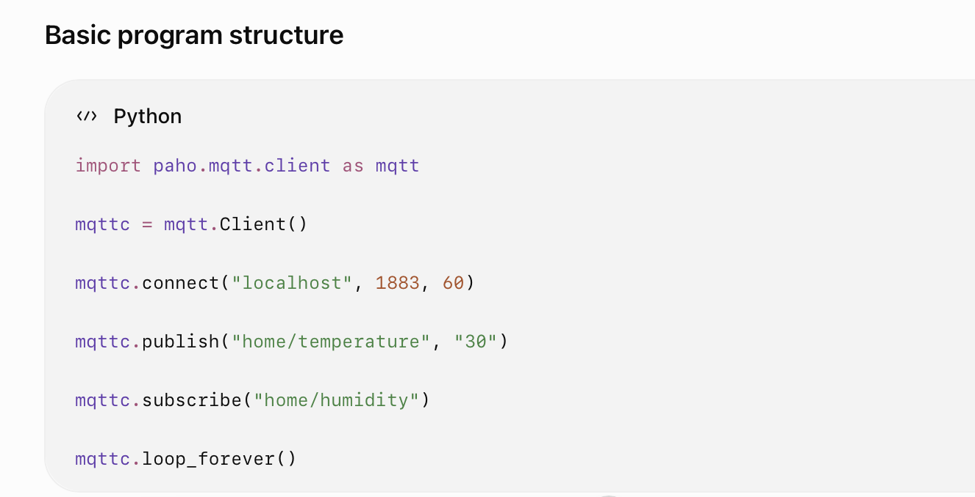

Slide 19
Thank You
Vraj Suratwala
Department of ICT, VNSGU

